Slide 1
Introducing Categorical Predictors Into a Multiple Regression Model
PSYC234 Week 12 January 2025
Dr. Emma Mills e.mills@lancaster.ac.uk

Slide 2
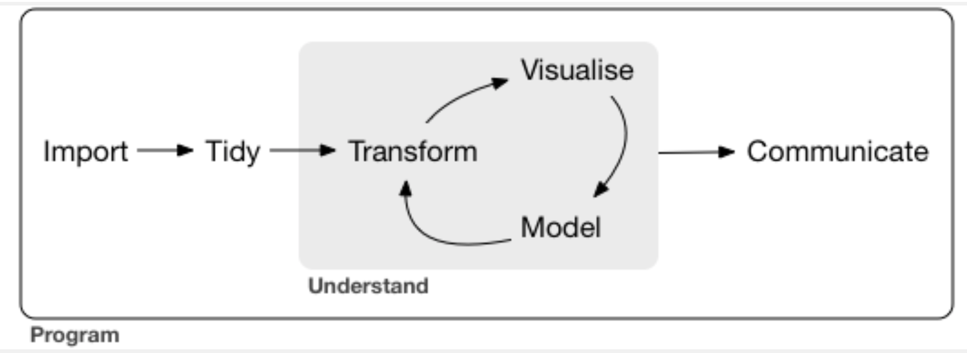
Week 12: Analysing using the workflow

Slide 3
Multiple Regression: Raw data
Continuous OR categorical predictors
Y = Intercept + predictor 1 + predictor 2 + Error
Y = b₀ + b₁ * X₁ + b₂ * X₂ + Error
Intercept = value of the outcome variable when all continuous predictors are at zero and categorical predictors are at their reference level
Interpretation for continuous coefficients =
A one unit increase in X₁ gives a change in Y by the amount of b₁
Interpretation for categorical coefficients =
A change to another category within X₂ gives a change in Y by the amount of b₂

Slide 4
Categorical variables
Examples of variables with two levels
Predictor | Level 1 | Level 2
Sex | Female | Male
Smoker | No | Yes
Accuracy | 0 | 1
Accuracy | No | Yes
Group | Control | Treatment

Slide 5
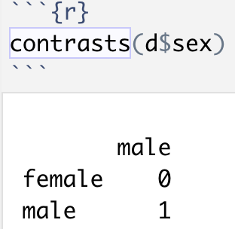
How does R manage categorical variables?
Default contrast scheme in R for categorical variables
this is known as “Dummy coding” or “treatment coding”
0 to a level 1
1 to level 2
The level coded as 0 = variable reference level
Level that comes first in the alphabet / numerically
The reference level of an categorical variable is part of the Intercept term of a regression model

Slide 6
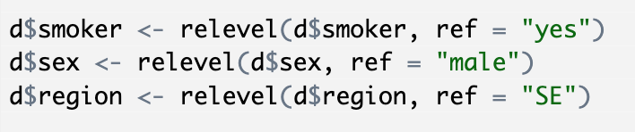
Changing the reference level of a variable
Your hypothesis may mean a different reference level makes it easier to interpret
This may be useful in the context of factors with more than two levels
You can change the reference level by using the relevel() function to manually reorder the levels of your grouping variable
There are other ways too

Slide 7
RStudio Demonstration

Slide 8
Dummy Coding & Sum Coding – a difference
0 +1
male
female

Slide 9
Sum Coding: preparing for interactions
example code:
variable to change
No. of levels in my
categorical variable
Show me the levels
change my contrast scheme to sum coding

Slide 10
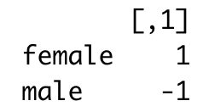
Sum Coding: preparing for interactions
example output:

Slide 11
Sum Coding: preparing for interactions
-1 0 +1
male
intercept
female

Slide 12
Sum Coding: preparing for interactions
-1 0 +1
male
intercept
female

Slide 13
Sum Coding: preparing for interactions
-1 0 +1
male
intercept
female

Slide 14
Sum Coding: preparing for interactions
Much better choice if you are including interactions in your regression model
Instead of 0 and 1, -1 and +1 are used
Intercept is now at 0
Categorical predictor is now “centred” (explained later)
Like continuous predictors
This type of contrast can help for interpreting interactions that occur between categorical and continuous predictors

Slide 15
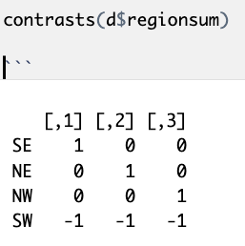
Sum Coding: preparing for interactions
More than two levels in a variable – is it still two jumps?
No

Slide 16
RStudio Demonstration

Slide 17
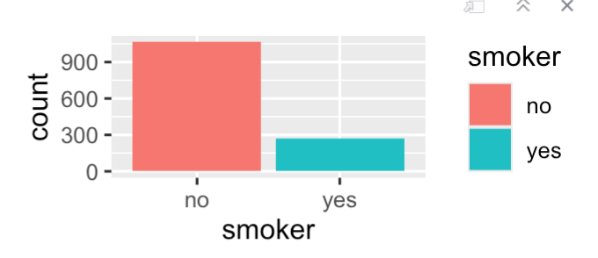
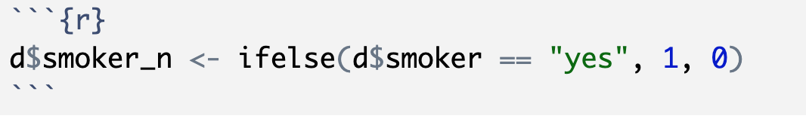
Unbalanced Binary Categorical Variables 1

Slide 18
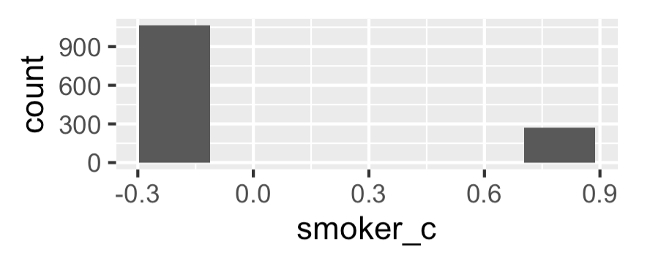
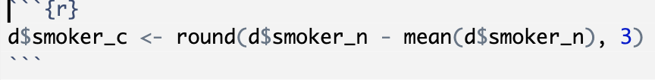
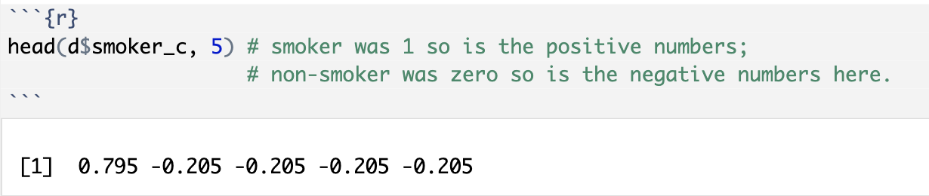
Unbalanced Binary Categorical Variables 2

Slide 19
Mean centering your continuous predictors
Remember that the raw intercept term represents the average value when all predictors are at zero
So the coefficients are interpreted as the change in Y for some value (larger than 0) the X predictor
An Intercept like this often doesn't make sense for the verbal model, i.e. the research questions or our hypotheses
What does an intercept term of 0 years or 0 kgs mean?
If we mean-centre the continuous predictors, the Intercept now represents the average value when all continuous predictors are at their average value

Slide 20
Mean centering your continuous predictors
Subtract the mean value of a variable from every observation in that variable
The mean of the variable is then = 0
All values are “centred” around zero
Some will be below zero, some will be above
The intercept term in your model now represents the intercept at the average for the predictor
The predictors are still in their raw units (e.g. years / kgs)
(learn to do these techniques by hard coding – easy to do and the common function that is used (scale()) doesn’t play very nicely with some other packages!)

Slide 21
RStudio Demonstration

Slide 22
One step further: standardising
Take your centred variable and divide each observation by one standard deviation of the variable
Interpretation is now a one standard deviation decrease / increase in the predictor is a (part of) standard deviation in the outcome variable.
Because all predictors are now measured in standard deviation units, instead of their raw units, you can compare the size of their coefficients. You couldn’t do this before because they were in different units.
Dividing by 2 standard deviations allows you to directly compare the coefficients for continuous and binary predictors.

Slide 23
RStudio Demonstration

Slide 24
More than two levels…
What about categorical variables with more than two levels?
Dummy / treatment coding - each level’s coefficient is the difference between the reference level and one other level
Sum coding – each level’s coefficient is the difference of the level from the intercept
In variables with more than one level, To find the value of -1 , you have to calculate the sum of the intercept and all the other levels of the variable. – demonstrated earlier

Slide 25
…and ordered variables…
Ordered outcome variables use ordinal regression model (week 19)
Ordered predictor variables use “helmert” contrast coding
Each level of the coefficient is the difference between those level or levels below them
To get the value of the n^{th} level in an ordered variable, you add all the other coefficients that come before that level to the intercept.

Slide 26
Summary: Dummy coding
Reference level in dummy coding becomes hidden in the intercept for the categorical predictor
It’s a good idea to write out what your intercept represents before you start to interpret your model
If dummy coding is used, switching from one level of the categorical predictor to the second level is the same as moving along one unit of a continuous predictor
It follows that for a binary categorical predictor, the slope term is giving you the mean difference between the two groups.

Slide 27
Summary: Sum coding
Intercept now reflects 0 rather than the reference level
If sum coding is used, switching from one level of the categorical predictor to the second level is the same as moving along two units of a continuous predictor
compared to the raw model, binary variable coefficients will be half the size
For variables of more than two levels, you need to add all the coefficients in the model summary together to find the coefficient for the -1 variable

Slide 28
Summary: Standardising variables
Centre a predictor and then divide the observation by the standard deviation of the variable
Great for preparation for a model with interactions
Each standardized variable now predicts the change in the outcome variable for a one standard deviation increase in the predictor variable
Each standardized variable can now be compared with each other – allowing for judgements about relative strengths of predictors

Slide 29
Summary: Helmert Contrasts for Ordered Variables
Ordered predictor variables use “helmert” contrast coding
The first coefficient is the change in Y for the difference between the first two ranks or levels of the variable
The next coefficient is the change in Y for that specific level and the first two levels put together
The next coefficient is the change in Y for that specific level and the first three levels put together
…and so on

Slide 30
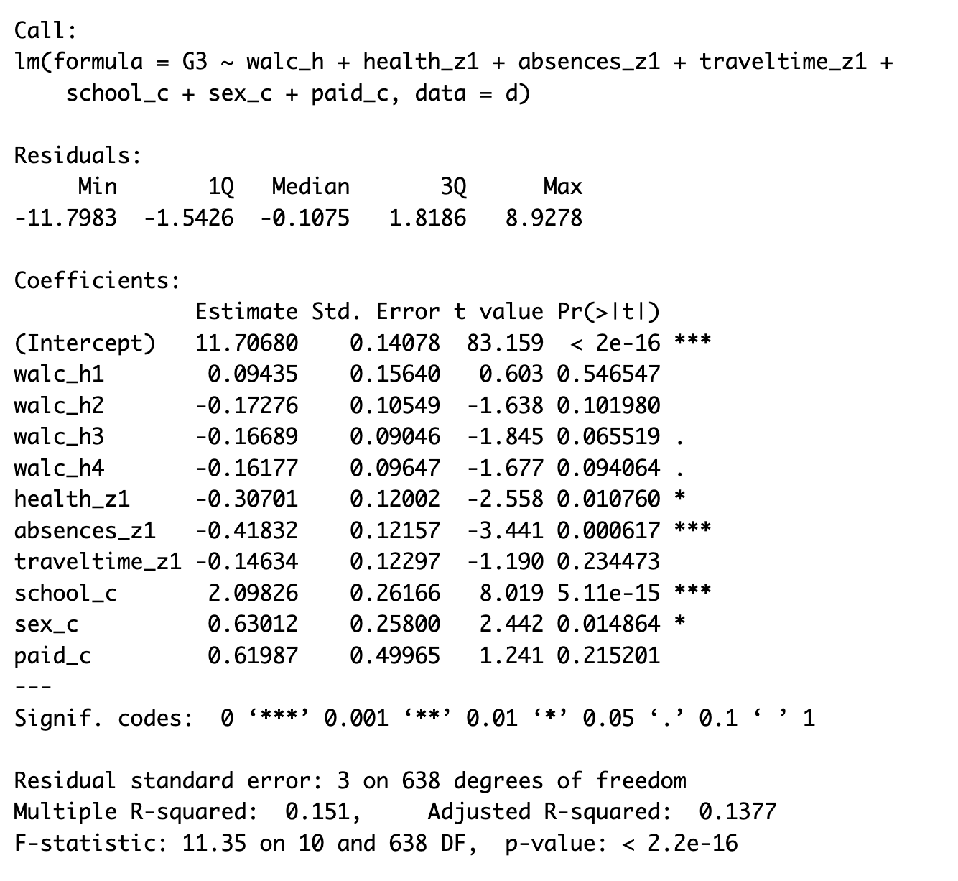
Pre-Lab and Lab Activity: Week 12
Dataset: “student-por.csv”
Codebook available: Yes
Skeleton script available: Yes
Before and in the lab: use the model output on the left, and generate an analysis script to as close an approximation as you can get to this model.
There is this output plus images of plots on the webpage and in the zip files that come down with the lecture materials that can be used as self checking tools.

